Slide 1
OOPJ Question Paper

Slide 2
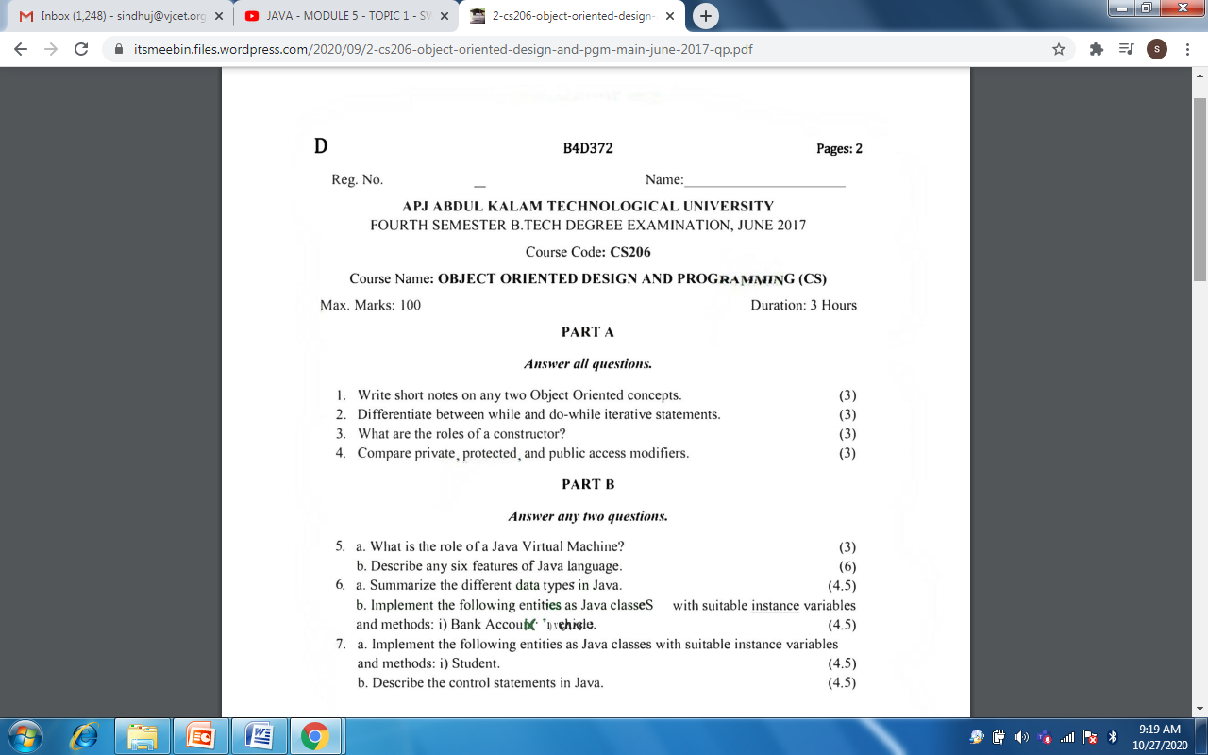

Slide 3
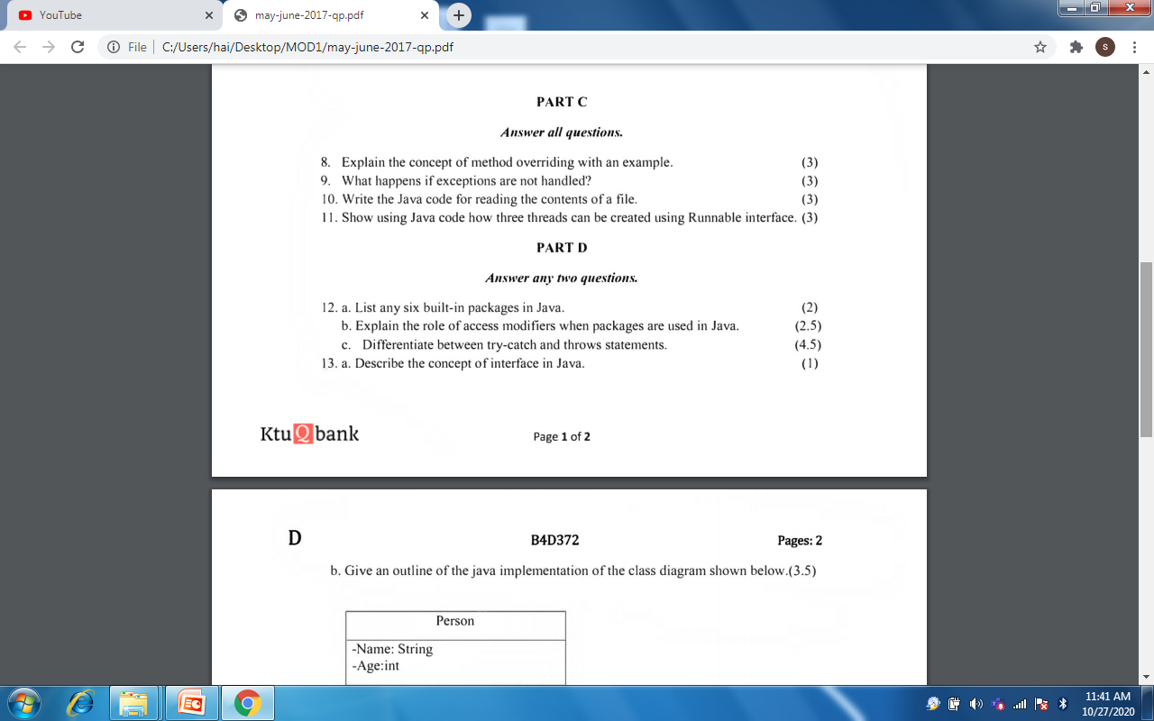

Slide 4
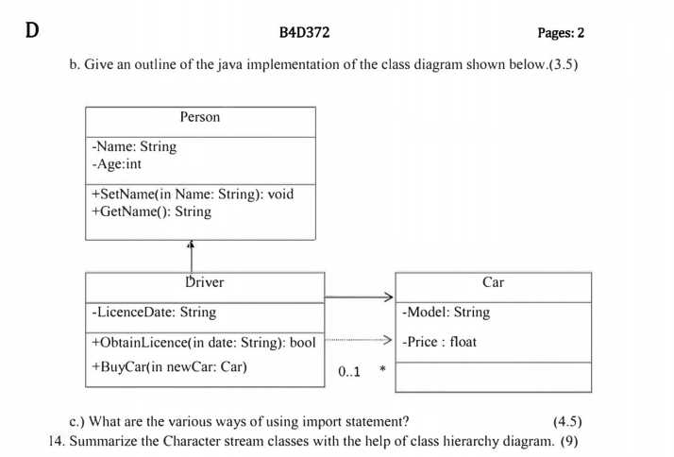

Slide 5
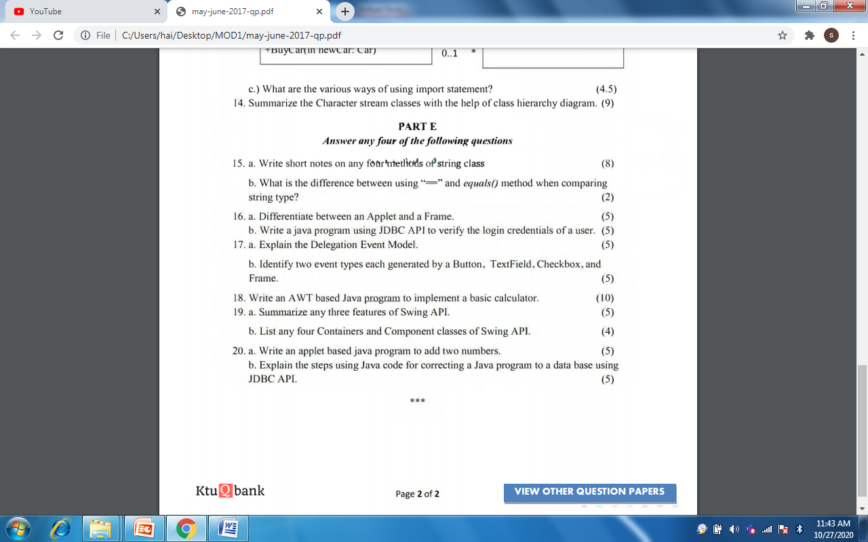

Slide 6
Q 6.b.i
import java.io.*;
class BankAccount1{
String name;
long id;
public int bal;
BankAccount1()
{ name=" "; id=0; bal=0; }
void assignvalues() throws IOException {
BufferedReader br=new BufferedReader(new InputStreamReader(System.in));
System.out.println("Enter name");
name=br.readLine();
System.out.println("Enter Acct no");
id=Integer.parseInt(br.readLine());
System.out.println("Enter initila balance");
bal=Integer.parseInt(br.readLine()); }

Slide 7
int depositmoney() throws IOException{
BufferedReader br=new BufferedReader(new InputStreamReader(System.in));
System.out.println("Enter amount to be deposited");
int dep=Integer.parseInt(br.readLine());
bal=bal+dep;
return bal; }
public static void main(String args[]) throws IOException {
BankAccount1 b=new BankAccount1();
int c;

Slide 8
do {
System.out.println("1.Assign values 2. DepositMoney 3.exit");
BufferedReader br=new BufferedReader(new InputStreamReader(System.in));
c=Integer.parseInt(br.readLine());
switch(c){
case 1: b.assignvalues();
break;
case 2:
int balance=b.depositmoney();
System.out.println("New balance is "+balance);
break;
case 3:
System.out.println("You are exiting");
break;
}
}while(c!=3); } }

Slide 9
Q12)
java.lang
java.io
java.util
java.applet
java.awt
java. awt.event

Slide 10
Q 12) class Person{
private String Name;
private int age;
public void SetName(String name) {
Name=name; }
public String GetName(){
return Name; }
}
class Driver extends Person{
private String LicenceDate="2020";
public boolean ObtainLicence(String date){
if(...)
return true;
else
return false; }

Slide 11
public void Buycar(car car1)
{
......
}
class car
{
....
}
class Test
{
public static void main(String args[])
{
Person p=newPerson();
p.SetName("aby");
.... } }

Slide 12
Q 13.c
1.Using fully qualified name
package pack1;
public class A{---
}
package pack2;
class b{
public static void main(String args[])
{
pack1.A obj=new pack1.A();

Slide 13
2. Import the only class
import pack1;
3.Import all classes in packages
import pack1.*;

Slide 14
Q 20) public class Calc extends Applet implements ActionListener
{
TextFiled t1=new TextField(10); int n2=Integer.parseInt(t2.getText());
TextFiled t2=new TextField(10); t3.setText( n1+n2);
TextFiled t3=new TextField(10); } //close if
Label l1=new Label(“First no”); } // close actionPerformed
Label l2=new Label(“Second no”); } // close Calc
Label l3=new Label(“Sum”);
Button b=new Button(“ADD”);
public void init(){
add(t1);add(t2)……
b.addActionListener(this); }
public void actionPerformed(ActionEvent e)
{
if(e.getSource()==b) {
int n1=Integer.parseInt(t1.getText());

